Slide 1
Non-classical Secreted Protein Prediction
Supervisor : Dr Matthew Chua
Student: Norvin Chandra – A0195335Y
04 July 2020

Slide 2
Contents
Background
Objectives
Current Model
Initial Technical Approach
Data Acquisition
Data Processing
Initial Modelling
Challenges
Next Step

Slide 3
Background
Bacteria species are commonly classified by their Gram staining which is a method of coloring cells red or violet
Gram-positive bacteria has thick layer of peptidoglycan in cell wall that retains crystal violet
Gram-negative bacteria has thinner peptidoglycan layer that allow crystal violet to wash out on addition of ethanol. This class of bacteria is stained pink or red by counterstain.
This project deals with secretion of protein from gram-positive bacteria through non-classical pathway, i.e. protein secreted by a pathway other than Sec translocon or Tat transporter.
According to Yanju Zhang, et al. in PeNGaRoo paper, “Among all secreted protein, ‘non-classical’ secreted proteins are difficult to identify as they lack discernible signal peptide sequences.”

Slide 4
Objective and Deliverable
To build a classification model to detect non-classical secreted protein from gram-positive bacteria with AUC > 0.85 when tested on the independent test dataset.
Validation will be based on independent test data set provided in PeNGaRoo website

Slide 5
Current BENCHMARK Model
The PeNGaRoo curated own verifiable training and testing dataset on which this project will be based upon
Extract features from 3 different groups: sequence-derived features, evolutionary information based features, physicochemical property based features
Train model on each chosen feature set using Light Gradient Boosting Machine then equal-weight averaging of prediction outputs of feature encoding within same group.
Integrate single machine learning based models into single ensemble model to enhance the prediction performance
Thereafter construct 2 layer LightGBM based ensemble model to take advantage of different feature groups
Instead of merging all features into a higher-dimensional feature set, the team trained base models with each feature sets to learn different useful pattern from various feature sets. When integrating base models, rather than using direct integration which might suffer from information redundancy within same feature group, the team adopted a two-layer ensemble model strategy.

Slide 6
Initial Technical Approach
Use the training dataset constructed by PeNGaRoo team to generate protein features in iFeature web server
Run the training data set on TPOT auto ML to identify potential features and method combination
Select 2 best combination to manually build model and tweak parameters to optimize prediction result
Alternative approach:
Fuse potential features and train on tweaked model
Ensemble models

Slide 7
Data Acquisition
Protein sequence in FASTA format was obtained from http://pengaroo.erc.monash.edu/download.jsp
Data used for this project:
PeNGaRoo_train_N.fasta (negative)
PeNGaRoo_train_P.fasta (positive)
PeNGaRoo_independent_test_N.fasta
PeNGaRoo_independent_test_P.fasta

Slide 8
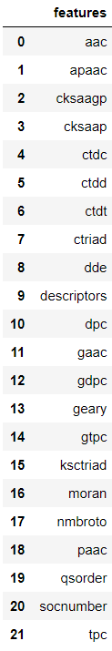
Data Processing
Data processing steps:
Load each train and independent test data to iFeature to obtain protein features for subsequent modelling
Combine respective negative features and positive features to form overall training and independent testing data set
Output of iFeature:
21 pairs of positive and negative training features (“descriptors” is not a feature, it is a file containing all the features)
21 pairs of positive and negative independent test features (“descriptors” is not a feature, it is a file containing all the features)

Slide 9
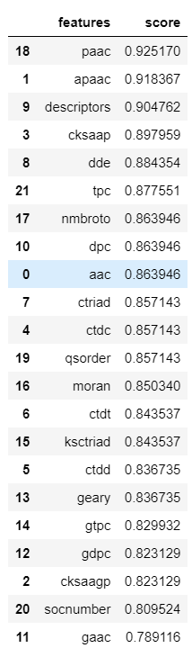
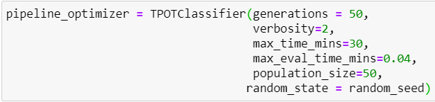
Initial Modelling
Using Python TPOT package to identify potentially best performing features and pipeline combination
1st iteration using the following TPOT configuration:
Result →
Paac on KNN
Apaac on KNN
Cksaap on SGDClassifier
Dde on Gaussian Naive Bayes
Tpc on Bernoulli Naïve Bayes

Slide 10
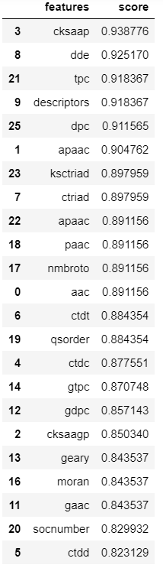
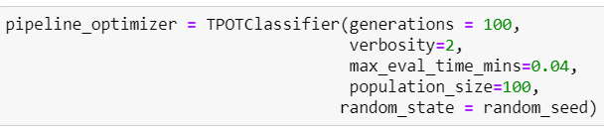
Initial Modelling, cont’d
2nd iteration using the following TPOT configuration:
Took approximately 4 days to run.
Results →
Cksaap on LinearSVC
Dde on KNN
Tpc on LinearSVC
Dpc on MLPClassifier
Apaac on KNN

Slide 11

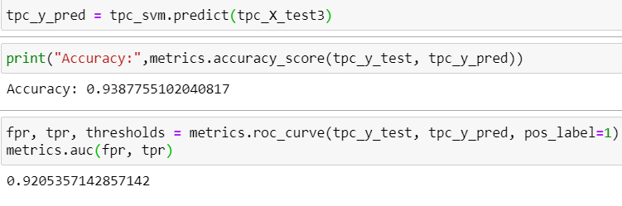

Initial Modelling, cont’d
Attempt 1 – tpc on LinearSVC
Accuracy on validation data set is 93.8% with AUC of 0.92
However when the model is used against independent test data, the accuracy drops to only 50%

Slide 12
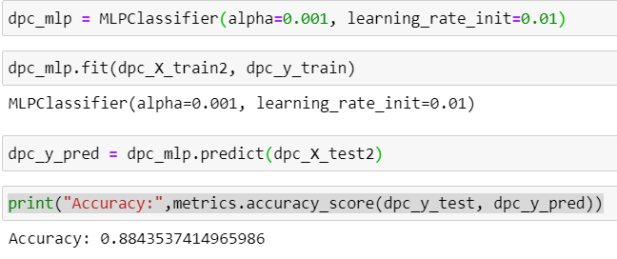
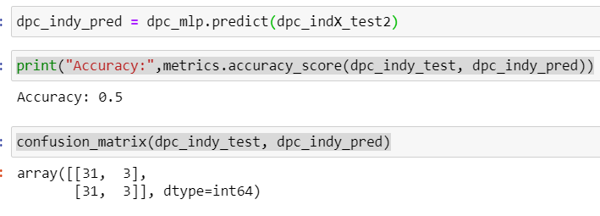
Initial Modelling, cont’d
Attempt 2 – dpc on Multi Layer Perceptron Classifier
Accuracy on validation data set is 88.4% but once tested on independent test data, accuracy drops to 50%

Slide 13
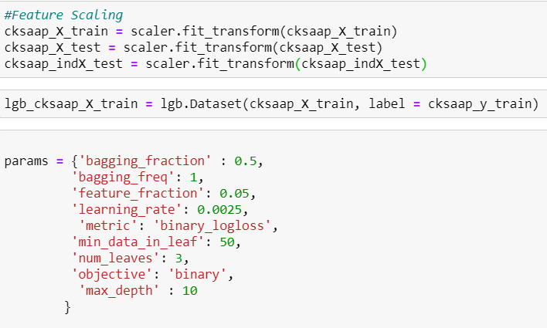
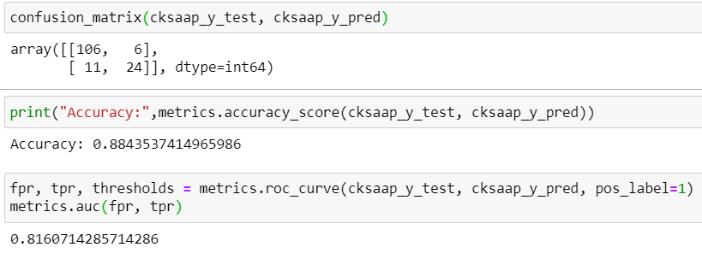
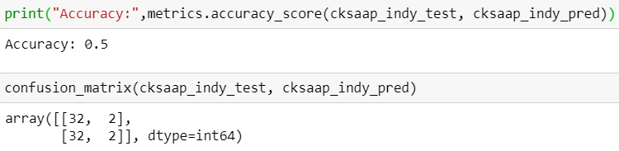
Initial Modelling, cont’d
Attempt 3 – cksaap with LightGBM
Accuracy on validation data set is 88%
Again, when tested on independent test data, accuracy drops to 50%

Slide 14
Challenges
Understanding each feature set is challenging for someone not in the domain
Learning more sophisticated modelling techniques
Attempt to reproduce PeNGaRoo model using original source code (in R) and original data set results in fatal error
Difficulty in finding source code for journals featuring feature fusion
Attempt to find potential pipeline using TPOT takes time. 100 generations with population_size of 100 takes about 4 days to complete
Potential pipeline + feature combinations produce poor accuracy when tested on independent test data set

Slide 15
Next Step
Further reading on sequence-derived features, evolutionary information based features, physicochemical property based features
Further research on other feature transformation / fusion and ensemble modelling technique
Find out reason for the poor performance of current models when tested on independent test set
Guidance on possible methodology and sample codes to reverse engineer solution will be highly appreciated and will greatly assist this project

Slide 16
THANK YOU

Slide 17
STACKED classifier Optimized with optuna for predicting non classical secreted protein – Phase 2
Supervisor : Dr Matthew Chua
Student: Norvin Chandra – A0195335Y
23 Oct 2020

Slide 18
RECAP
Recap:
Objective:
To build a classification model to detect non-classical secreted protein from gram-positive bacteria with AUC > 0.85 when tested on the independent test dataset
Data
Protein sequence in FASTA format was obtained from http://pengaroo.erc.monash.edu/download.jsp
Train Data: 587 records with 446 negatives and 141 positives
Independent Test Data: 68 records with 34 negatives and 34 positives
Protein Sequence uploaded to iFeature web server (https://ifeature.erc.monash.edu/) to generate multiple protein features for analysis
Focused on the following efforts:
Build ensemble model as single models do not seem to produce good enough AUC. Experimented on sklearn StackingClassifier
Feature selection using XGBoost feature_importances on protein sequence with huge number of attributes

Slide 19
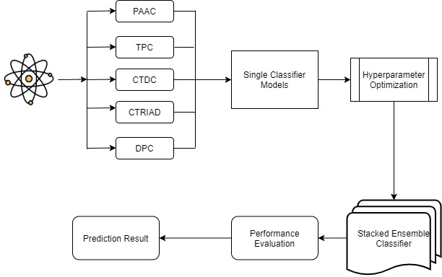
Model Approach

Slide 20
Data preparation
Data Preparation
Protein Sequence Selection
MinMax Scaling Train and Independent Test Data
Model Design
Independent Models
Stacked Classifier
Optimization
Optuna
After trial on CTDC, PAAC, TPC, DPC and CTRIAD we decided to use CTDC for the following reasons:
Base line stacked model perform best among the 5 protein features (CTDC: 86.7%, PAAC: 84%, TPC: 83%, DPC: 82%, CTRIAD: 72%)
It has least number of attributes of 39 as compared to TPC with more than 8000 attributes
No missing data
Scale Training and Independent Test Data separately using MinMaxScaler.

Slide 21
Model design – independent model
Data Preparation
Protein Sequence Selection
MinMax Scaling Train and Independent Test Data
Model Design
Independent Models
Stacked Classifier
Optimization
Optuna
Model | AUC Score on independent Test Data before Hyperparameter Optimization
Logistic Regression | 78%
SVM | 75%
Linear SVC | 79%
XGB | 75%
Extra Tree Classifier | 71%
KNN | 71%
Random Forest | 76%
Try out the following classifier independently
Logistic Regression
KNeighbors Classifier
Linear SVC
SVC
Extra Tree Classifier
Random Forest
XG Boost Classifier

Slide 22
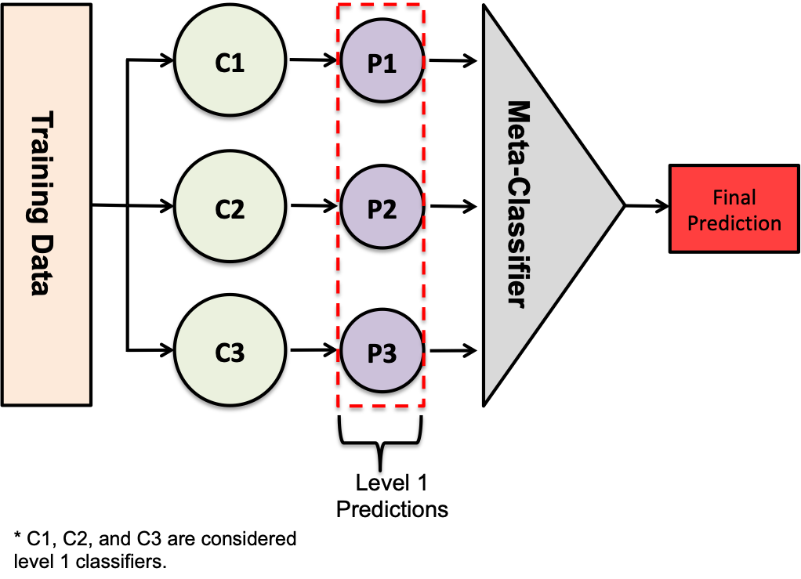
Model design – Stacked ensemble classifier
Using the Predictive Capability of Multiple Classifiers to Boost Performance beyond performance of any single model in the ensemble
Prediction of multiple classifiers in Level 1 (Base Models) get stacked and used as features to train meta-classifier (Meta Model) which makes final prediction
Source: Stacking Classifiers for Higher Predictive Performance - https://towardsdatascience.com/stacking-classifiers-for-higher-predictive-performance-566f963e4840

Slide 23
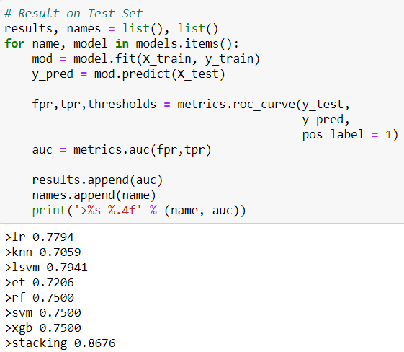
Model design – STACKED Ensemble classifier
Data Preparation
Protein Sequence Selection
MinMax Scaling Train and Independent Test Data
Model Design
Independent Models
Stacked Classifier
Optimization
Optuna
Tried base line stacking by using all the independent models as Base Model and LogisticRegression as Meta-Classifier.
AUC on Independent Test Data: 86.76%
At this point, the AUC on Independent Test Data is already better than the target of 85%

Slide 24
Model optimization – Bayesian hyperparameter optimization using optuna
Bayesian hyperparameter optimization is performed by building a probability model of the objective function and use it to select the most promising hyperparameters to evaluate in the true objective function
Grid search and random search are completely uninformed by past evaluations.
Bayesian approach keeps track of past evaluation results and uses the results to form a probabilistic model mapping hyperparameters to a probability of a score on the objective function.
By evaluating hyperparameters that appear more promising from past results, Bayesian methods can find better model settings than random search in fewer iterations.
Source: A Conceptual Explanation of Bayesian Hyperparameter Optimization for Machine Learning - https://towardsdatascience.com/a-conceptual-explanation-of-bayesian-model-based-hyperparameter-optimization-for-machine-learning-b8172278050f

Slide 25
Model design – Hyperparameter optimization using optuna
Data Preparation
Protein Sequence Selection
MinMax Scaling Train and Independent Test Data
Model Design
Independent Models
Stacked Classifier
Optimization
Bayesian Hyperparameter Optimization - Optuna
Optimize hyperparameter for independent models in level 1 (Base Model)
Reduce number of Base Model from current count of 7 to improve run time
Stack the optimized model and predict on independent Test data

Slide 26
Optimization – on individual model
Model | AUC Score on independent Test Data before Hyperparameter Optimization | AUC Score on independent Test Data after Hyperparameter Optimization using Optuna
Logistic Regression | 78% | 81%
SVM | 75% | 81%
Linear SVC | 79% | 78%
XGB | 75% | 76%
Extra Tree Classifier | 71% | 75%
KNN | 71% | 72%
Random Forest | 76% | 71%
Data Preparation
Protein Sequence Selection
MinMax Scaling Train and Independent Test Data
Model Design
Independent Models
Stacked Classifier
Optimization
Bayesian Hyperparameter Optimization - Optuna

Slide 27
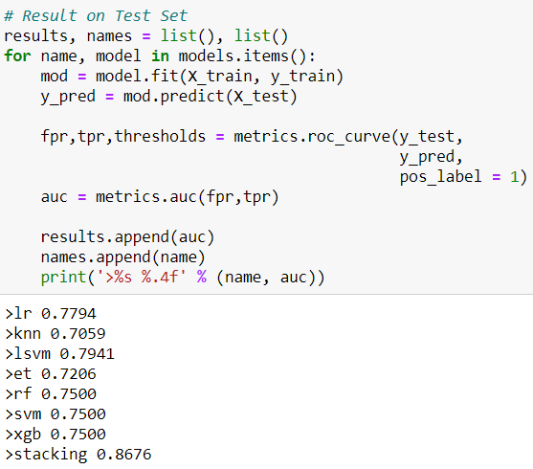
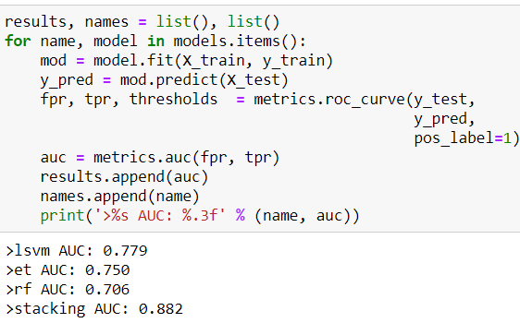
Optimization – Stacked Classifier
After iterations, we decided to use the combination of optimized Linear SVC, Extra Tree Classifier and Random Forest as Level 1 models
Data Preparation
Protein Sequence Selection
MinMax Scaling Train and Independent Test Data
Model Design
Independent Models
Stacked Classifier
Optimization
Bayesian Hyperparameter Optimization - Optuna
Before Optimization
After Optimization

Slide 28
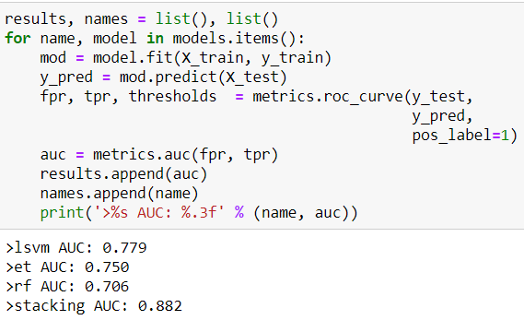
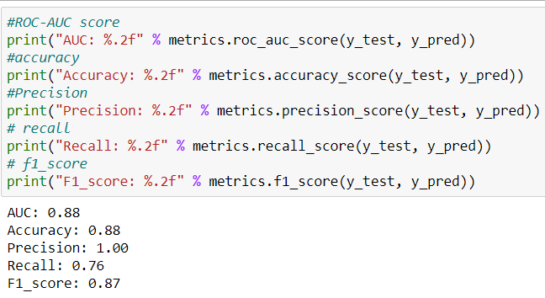
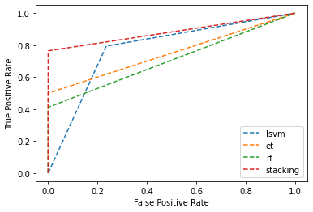
Final result
Model evaluated using cross_val_score with 10 folds
ROC AUC on independent test data: 88.24%, higher than PeNGaRoo AUC on independent test data of 85.2%

Slide 29
Next
To explore Meta Classifier optimisation using Optuna
Explore “pruned-cv” package by Piotr Gabrys to shorten the hyperparameter optimisation time by automatically stopping unpromising trials at early stages of training.
Try other Protein Sequence
Protein Sequence Fusion
Reference: Pruned Cross Validation for Faster Hyperparameter optimization - https://towardsdatascience.com/pruned-cross-validation-for-hyperparameter-optimization-1c4e0588191a

Slide 30
THANK YOU

